Slide 1
KINGDOM INFLUENCERS
Leading Change & Casting Vision

Slide 2
CHANGE
I don’t want

Slide 4
CHANGE

Slide 5
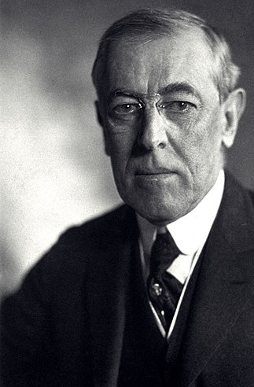
Woodrow Wilson US President
“If you want to make enemies, try to CHANGE something”

Slide 6
THE CHALLENGE
The greatest challenge of pastoral ministry lies in that although we all strive to resist change, God has called us to lead people through change.
The word of God compares us with sheep, because we are creatures of habit, and we will persist repeating the same motions unless a shepherd leads us through change.
Leading change calls for VISION!
Leading Change

Slide 7
Rescuing the need for VISION
The concept of church vision has been often misused, overused, misapplied, and misunderstood
The Church Growth Movement
The Missional Church Movement
Vision is NOT a borrowed concept
When we ignore vision, we make other elements the drivers of ministry

Slide 8
“Where there is no vision, the people perish”
Proverbs 29:18

Slide 9
The Life Cycle of Church Maturity
Fellowship
Structure
Vision
Programs
Notes:
If you were to get a group of church goers and asked the question, “What is the most important

Slide 10
VISION
FELLOWSHIP
PROGRAMS
STRUCTURE
Thriving
Pattern
Stagnation
Pattern

Slide 11
The Power of a Vision
It is vision that propels us to do, to pursue, to conquer, to achieve, to overcome, and to continue against all odds, for a vision is the overwhelming certainty that the present situation is not acceptable, and that we have been called for more.

Slide 12
VISION: A clear vivid picture of what can be.
The GOSPEL Message!
SUCCESS: Capturing, articulating and engaging in God’s unique vision for a particular church at a particular time.
What is Success?

Slide 13
Signs that Vision is Lacking
10

Slide 14
When Vision is Lacking
1. Nobody can state the vision.
2. Leadership tends to be reactive rather than proactive.
3. Leaders are often divided.
4. Ministries are disorganized.
5. Passions, rather than planning, ignite the church’s activities.
Notes:
10 Signs that your church lacks vision by Chuck Lawless - https://outreachmagazine.com/features/22393-church-lacks-vision.html

Slide 15
When Vision is Lacking
6. Internal conflict festers.
7. The goal seems to be to “get through the next weekend,” rather than to maximize efforts to reach the unchurched.
8. Budget expenditures are a big deal.
9. Many church members just sit.
10. Strong leaders don’t stay long.

Slide 16
Crucial Reasons for Casting Vision
7

Slide 17
1. It elevates the PRAYER life of the church
2. It provides a common goal and DIRECTION
3. It brings the church TOGETHER
4. It is a point of reference for DECISION MAKING and ministry initiatives.
5. It is an open invitation for RESOURCES
6. Vision is a powerful EVANGELISTIC tool
Notes:
10 Signs that your church lacks vision by Chuck Lawless - https://outreachmagazine.com/features/22393-church-lacks-vision.html

Slide 18
7. It is the most powerful tool for CHANGE!
Notes:
10 Signs that your church lacks vision by Chuck Lawless - https://outreachmagazine.com/features/22393-church-lacks-vision.html

Slide 19
How do we start casting VISION?

Slide 20
Vertical & Horizontal COMMUNION
PRAYER
The vision belongs to God
He must reveal it
Collaboration
We are not the one only recipients
God reveals it to the body

Slide 21
“Now it came to pass in the thirtieth year, in the fourth month, in the fifth day of the month, as I was among the captives by the river of Chebar, that the heavens were opened, and I saw visions of God”
Ezekiel 1:1-1

Slide 22
“Now it came to pass in the thirtieth year, in the fourth month, in the fifth day of the month, as I was among the captives by the river of Chebar, that the heavens were opened, and I saw visions of God”
…Of God
God is the giver of vision
Ezekiel 1:1-1

Slide 23
“Now it came to pass in the thirtieth year, in the fourth month, in the fifth day of the month, as I was among the captives by the river of Chebar, that the heavens were opened, and I saw visions of God”
…Among them
Vision is revealed as we are among the people and is relevant to the social issues of the people
Ezekiel 1:1

Slide 24
“Now it came to pass in the thirtieth year, in the fourth month, in the fifth day of the month, as I was among the captives by the river of Chebar, that the heavens were opened, and I saw visions of God”
…the place
Vision is relevant for a specific geographical location
Ezekiel 1:1

Slide 25
“Now it came to pass in the thirtieth year, in the fourth month, in the fifth day of the month, as I was among the captives by the river of Chebar, that the heavens were opened, and I saw visions of God”
…for the time
Vision is relevant to the specific historical time
Ezekiel 1:1

Slide 26
Your ministry is unique
God designed your ministry with its own DNA code
Your vision is unique
The Vision
is Unique

Slide 27
What Makes your Church Unique?
Leaders: what are the strengths of the leadership?
Gifts: What is the mix of spiritual gifts?
Heritage: What is their history?
Experiences: What have they lived through?
Tradition: How do they celebrate their faith?
Values: What is most important?
Personality: What is the mix of personalities?
Evangelism: How do you convey the gospel?
Recovery: What is the pattern of sin and restoration?
Motivation: What does your people love the most?
Notes:
10 Signs that your church lacks vision by Chuck Lawless - https://outreachmagazine.com/features/22393-church-lacks-vision.html

Slide 28
Discovering your UNIQUE vision anointing

Slide 29
Unique Vision Equation
UV = 4P.Q? X P^

Slide 30
What is your PREDICAMENT?
What is your POWER?
What is your PASSION?
What is your PAST?
4PQ?
The 4 P Questions

Slide 31
What are the current needs and opportunities where God has placed your church?
How are these needs reflected socially, economically, ethnically, environmentally, politically, and religiously?
What special opportunities are found within our immediate sphere of influence (within a half-mile)?
What are the largest community events, and what needs or opportunities do they create?
What is the most significant change in our community in the last decade, and what need does this create?
Predicament
What are the current needs and opportunities where God has placed your church?

Slide 32
What one thing bothers you most about the world?
If you knew you couldn’t fail, what one thing would you pursue for God?
What do you tend to pray for the most?
What would you want people saying about you at your funeral?
Who are your heroes? Why do you admire them? Who have you wanted to emulate or spend time with but have not been able to?
Passion
What motivates, inspires and energizes your people?

Slide 33
If you were bringing a friend to our church for the first time, what singular promise (that is, what she will receive or experience from coming) would you be most willing to make?
If our church was immediately uprooted from the community, what would people in the community feel is missing?
What spiritual gifts seem to be prominent in our church?
How do new members talk about what attracted them to the church?
If we had to only do one ministry outside our church walls, which would we choose?
Power
What is the unique combination of gifts, talents and experiences?

Slide 34
How did the church start?
Who were the previous pastors and how did they minister to the church?
What have been the greatest celebrations and challenges in the past 10, 20, 30..., years.
Was there ever a defined vision? What was that vision? How does it connect with today’s environment and ministry.
If you make a historical timeline of the church, what trends can you identify?
Past
How has God ministered to the church in the past?

Slide 35
Prayer
P^
P^
“Call to Me, and I will answer you, and show you…
…great and mighty things, which you do not know.”
Jeremiah 33:3

Slide 36
Your Unique Vision
(Predicament + Passion + Power + Past) x Prayer

Slide 37
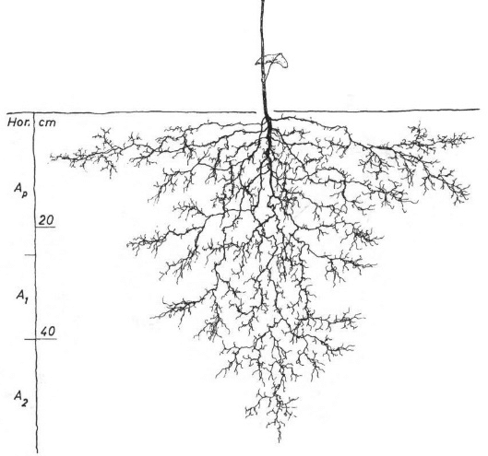
Predicament
Passion
Power
Prayer
Past

Slide 38
CHANGE
Without Vision

Slide 39
But when you start with VISION

Slide 41
¹⁷ that the God of our Lord Jesus Christ, the Father of glory, may give to you the spirit of wisdom and revelation in the knowledge of Him, ¹⁸ the eyes of your understanding being enlightened; that you may know what is the hope of His CALLING, what are the RICHES of the glory of His INHERITANCE in the saints, ¹⁹ and what is the exceeding greatness of His power toward us who believe, according to the working of His mighty power.
Ephesians
1:17-19
CALLING > purpose
RICHES > resources
INHERITANCE > identity

Slide 42
KINGDOM INFLUENCERS
Leading Change & Casting Vision

